Slide 1

Data Integration and Large Scale Analysis 11 Stream Processing
Slides credit: Matthias Boehm
Last update: Jan 19, 2024

Slide 2
Announcements/Org
#1 Course Evaluation and Exam
Evaluation period: Jan 15 – Feb 15
Exam date: Feb 10, 2:30 pm (60+min written exam)

Slide 3
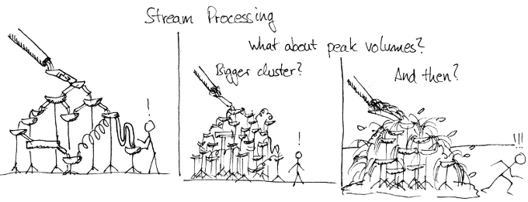
Agenda
Data Stream Processing
Distributed Stream Processing
Data Stream Mining

Slide 4
Data Stream Processing

Slide 5

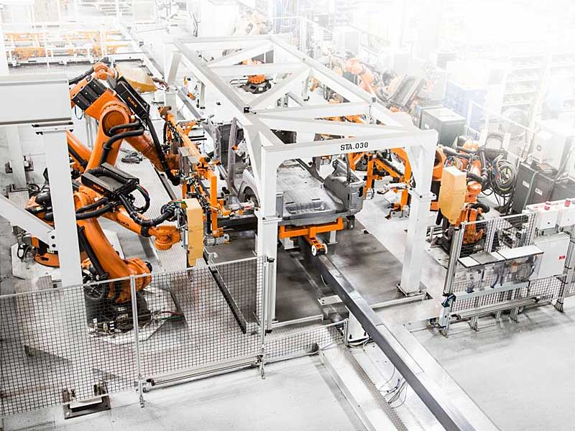
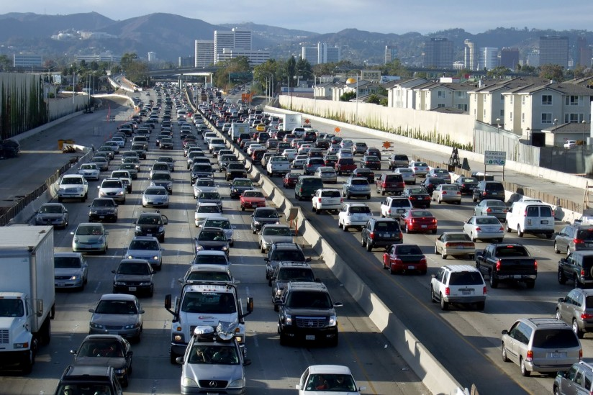
Stream Processing Terminology
Data Stream Processing
Ubiquitous Data Streams
Event and message streams (e.g., click stream, twitter, etc)
Sensor networks, IoT, and monitoring (traffic, env, networks)
Stream Processing Architecture
Infinite input streams, often with window semantics
Continuous (aka standing) queries
Stream Processing Engines
Queries
Input Stream
Output Stream
“data at rest”
DBMS
“data in motion”
Stored (Continuous) Queries
Stored Data

Slide 6
Stream Processing Terminology, cont.
Data Stream Processing
Use Cases
Monitoring and alerting (notifications on events / patterns)
Real-time reporting (aggregate statistics for dashboards)
Real-time ETL and event-driven data updates
Real-time decision making (fraud detection)
Data stream mining (summary statistics w/ limited memory)
Data Stream
Unbounded stream of data tuples S = (s₁, s₂, …) with s_{i} = (t_{i}, d_{i})
Real-time Latency Requirements
Real-time: guaranteed task completion by a given deadline (30 fps)
Near Real-time: few milliseconds to seconds
In practice, used with much weaker meaning
Continuously active

Slide 7




History of Stream Processing Systems
Data Stream Processing
2000s
Data stream management systems (DSMS, mostly academic prototypes): STREAM (Stanford’01), Aurora (Brown/MIT/Brandeis’02) → Borealis (‘05), NiagaraCQ (Wisconsin), TelegraphCQ (Berkeley’03), and many others
➔ but mostly unsuccessful in industry/practice
Message-oriented middleware and Enterprise Application Integration (EAI): IBM Message Broker, SAP eXchange Infra., MS Biztalk Server, TransConnect
2010s
Distributed stream processing engines, and “unified” batch/stream processing
Proprietary systems: Google Cloud Dataflow, MS StreamInsight / Azure Stream Analytics, IBM InfoSphere Streams / Streaming Analytics, AWS Kinesis
Open-source systems: Apache Spark Streaming (Databricks), Apache Flink (Data Artisans), Apache Kafka (Confluent), Apache Storm

Slide 8
System Architecture – Native Streaming
Data Stream Processing
Basic System Architecture
Data flow graphs (potentially w/ multiple consumers)
Nodes: asynchronous ops (w/ state) (e.g., separate threads)
Edges: data dependencies (tuple/message streams)
Push model: data production controlled by source
Operator Model
Read from input queue
Write to potentially many output queues
Example Selection σ_{A=7}
Archive
State
while( !stopped ) {
r = in.dequeue(); // blocking
if( pred(r.A) ) // A==7
for( Queue o : out )
o.enqueue(r); // blocking
}

Slide 9
System Architecture – Sharing
Data Stream Processing
Multi-Query Optimization
Given set of continuous queries (deployed), compile minimal DAG w/o redundancy (see DM 08 Physical Design MV) ➔ subexpression elimination
Operator and Queue Sharing
Operator sharing: complex ops w/ multiple predicates for adaptive reordering
Queue sharing: avoid duplicates in output queues via masks
T₁
T₂
T₁
T₂
∪
⋈_{A=B}
∪
⋈_{A=B}
σ_{a}
σ_{b}
σ_{c}
∪
σ_{d}
σ_{a}
∪
σ_{d}
S_{AS}
S_{US}
S_{EU}
σ_{b}
σ_{c}
Ad
S_{AS}
σ_{b}
σ_{c}
Ad
S_{US}
S_{EU}
S_{US}
S_{EU}

Slide 10
System Architecture – Handling Overload
Data Stream Processing
#1 Back Pressure
Graceful handling of overload w/o data loss
Slow down sources
E.g., blocking queues
#2 Load Shedding
#1 Random-sampling-based load shedding
#2 Relevance-based load shedding
#3 Summary-based load shedding (synopses)
Given SLA, select queries and shedding placement that minimize error and satisfy constraints
#3 Distributed Stream Processing (see last part)
Data flow partitioning (distribute the query)
Key range partitioning (distribute the data stream)
A
B
C
3ms
9ms
2ms
Self-adjusting operator scheduling
Pipeline runs at rate of slowest op
[Nesime Tatbul et al: Load Shedding in a Data Stream Manager. VLDB 2003]

Slide 11
Time (Event, System, Processing)
Data Stream Processing
Event Time
Real time when the event/ data item was created
Ingestion Time
System time when the data item was received
Processing Time
System time when the data item is processed
In Practice
Delayed and unordered data items
Use of heuristics (e.g., water marks = delay threshold)
Use of more complex triggers (speculative and late results)
skew
ideal
Processing Time
Event Time

Slide 12


Durability and Consistency Guarantees
Data Stream Processing
#1 At Most Once
“Send and forget”, ensure data is never counted twice
Might cause data loss on failures
#2 At Least Once
“Store and forward” or acknowledgements from receiver, replay stream from a checkpoint on failures
Might create incorrect state (processed multiple times)
#3 Exactly Once
“Store and forward” w/ guarantees regarding state updates and sent msgs
Often via dedicated transaction mechanisms
03 Message-oriented Middleware, EAI, and Replication
Notes:
Note: IBM MQ Series, AWS Simple Queueing Service (SQS)

Slide 13
Window Semantics
Data Stream Processing
Windowing Approach
Many operations like joins/aggregation undefined over unbounded streams
Compute operations over windows of (a) time or (b) elements counts
#1 Tumbling Window
Every data item is only part of a single window
Aka Jumping window
#2 Sliding Window
Time- or tuple-based sliding windows
Insert new and expire old data items
size = 2min
12:05
12:07
12:09
size = 2min, step = 1min
12:05
12:07
12:09

Slide 14

Stream Joins
Data Stream Processing
Basic Stream Join
Tumbling window: use classic join methods
Sliding window (symmetric for both R and S)
Applies to arbitrary join pred
See DM 08 Query Processing (NLJ)
Excursus: How Soccer Players Would do Stream Joins
Handshake-join w/ 2-phase forwarding
For each new r in R:
1. Scan window of stream S to find match tuples
2. Insert new r into window of stream R
3. Invalidate expired tuples in window of stream R
[Jens Teubner, René Müller: How soccer players would do stream joins. SIGMOD 2011]

Slide 15
Stream Joins, cont.
Data Stream Processing
[Zachary G. Ives, Daniela Florescu, Marc Friedman, Alon Y. Levy, Daniel S. Weld: An Adaptive Query Execution System for Data Integration. SIGMOD 1999]
Double-Pipelined Hash Join
Join of bounded streams (or unbounded w/ invalidation)
Equi join predicate, symmetric and non-blocking
For every incoming tuple (e.g. left): probe (right)+emit, and build (left)
H_{R,RID}
1, 2, 7
⋈_{RID=SID}
H_{R,RID}
1, 2
H_{R,RID}
1, 1, 2, 7
H_{S,SID}
1, 7, 7
H_{R,RID}
H_{S,SID}
1, 7
H_{R,RID}
1, 1, 2
H_{S,SID}
7
H_{S,SID}
1 | ab
7 | zy
2 | cd
1 | xw
emit 1(abxw)
emit 1(efxw)
1 | ef
7 | vu
emit 7(ghvu)
Stream R
Stream S
emit 7(ghzy)
7 | gh

Slide 16
Distributed Stream Processing

Slide 17
Query-Aware Stream Partitioning
Distributed Stream Processing
[Theodore Johnson, S. Muthu Muthukrishnan, Vladislav Shkapenyuk, Oliver Spatscheck: Query-aware partitioning for monitoring massive network data streams. SIGMOD 2008]
Example Use Case
AT&T network monitoring with Gigascope (e.g., OC768 network)
2x40 Gbit/s traffic → 112M packets/s → 26 cycles/tuple on 3Ghz CPU
Complex query sets (apps w/ ~50 queries) and massive data rates
Baseline Query Execution Plan
Query flow_pairs:
SELECT S1.tb, S1.srcIP, S1.max, S2.max
FROM heavy_flows S1, heavy_flows S2
WHERE S1.srcIP = S2.srcIP and S1.tb = S2.tb+1
Self join
⋈_{tb=tb+1}
High-level aggregation
γ₂
Query heavy_flows:
SELECT tb,srcIP,max(cnt) as max_cnt
FROM flows
GROUP BY tb, srcIP
Low-level aggregation
γ₁
Low-level filtering
σ
Query flows:
SELECT tb, srcIP, destIP, COUNT(*) AS cnt
FROM TCP WHERE ...
GROUP BY time/60 AS tb,srcIP,destIP
TCP

Slide 18
Query-Aware Stream Partitioning, cont.
Distributed Stream Processing
Optimized Query Execution Plan
Distributed plan operators
Pipeline and task parallelism
Host 4
⋈_{tb=tb+1}
γ₂
∪
γ₁
Partitioning on srcIP
σ
⋈_{tb=tb+1}
TCP
γ₂
Host 1
γ₁
Host 2
Host 3
γ₁
γ₁
γ₁
σ
σ
σ
σ
TCP
TCP
TCP
TCP

Slide 19
Stream Group Partitioning
Distributed Stream Processing
11 Distributed, Data-Parallel Computation
Large-Scale Stream Processing
Limited pipeline parallelism and task parallelism (independent subqueries)
Combine with data-parallelism over stream groups
#1 Shuffle Grouping
Tuples are randomly distributed across consumer tasks
Good load balance
#2 Fields Grouping
Tuples partitioned by grouping attributes
Guarantees order within keys, but load imbalance if skew
#3 Partial Key Grouping
Apply “power of two choices” to streaming
Key splitting: select among 2 candidates per key (works for all associative aggregation functions)
#4 Others: Global, None, Direct, Local
[Md Anis Uddin Nasir et al: The power of both choices: Practical load balancing for distributed stream processing engines. ICDE 2015]

Slide 20
Example Apache Storm
Distributed Stream Processing
Bolt 1
Example Topology DAG
Spouts: sources of streams
Bolts: UDF compute ops
Tasks mapped to worker processes and executors (threads)
Bolt 3
Bolt 2
Spout 1
Config conf = new Config();
conf.setNumWorkers(3);
topBuilder.setSpout("Spout1", new FooS1(), 2);
topBuilder.setBolt("Bolt1", new FooB1(), 3).shuffleGrouping("Spout1");
topBuilder.setBolt("Bolt2", new FooB2(), 2).shuffleGrouping("Spout1");
topBuilder.setBolt("Bolt3", new FooB3(), 2) .shuffleGrouping("Bolt1").shuffleGrouping("Bolt2");
StormSubmitter.submitTopology(..., topBuilder.createTopology());

Slide 21
Example Twitter Heron
Distributed Stream Processing
[Credit: Karthik Ramasamy]
Motivation
Heavy use of Apache Storm at Twitter
Issues: debugging, performance, shared cluster resources, back pressure mechanism
Twitter Heron
API-compatible distributed streaming engine
De-facto streaming engine at Twitter since 2014
Dhalion (Heron Extension)
Automatically reconfigure Heron topologies to meet throughput SLO
Now back pressure implemented in Apache Storm 2.0 (May 2019)
Data per day
Cluster Size
# of Topologies
# of Msgs per day
[Sanjeev Kulkarni et al: Twitter Heron: Stream Processing at Scale. SIGMOD 2015]
[Avrilia Floratou et al: Dhalion: Self-Regulating Stream Processing in Heron. PVLDB 2017]

Slide 22
Discretized Stream (Batch) Computation
Distributed Stream Processing
Motivation
Fault tolerance (low overhead, fast recovery)
Combination w/ distributed batch analytics
Discretized Streams (DStream)
Batching of input tuples (100ms – 1s) based on ingest time
Periodically run distributed jobs of stateless, deterministic tasks → DStreams
State of all tasks materialized as RDDs, recovery via lineage
Criticism: High latency, required for batching
[Matei Zaharia et al: Discretized streams: fault-tolerant streaming computation at scale. SOSP 2013]
Batch Computation
Sequence of immutable, partitioned datasets (RDDs)

Slide 23


Unified Batch/Streaming Engines
Distributed Stream Processing
Apache Spark Streaming (Databricks)
Micro-batch computation with exactly-once guarantee
Back-pressure and water mark mechanisms
Structured streaming via SQL (2.0), continuous streaming (2.3)
Apache Flink (Data Artisans, now Alibaba)
Tuple-at-a-time with exactly-once guarantee
Back-pressure and water mark mechanisms
Batch processing viewed as special case of streaming
Google Cloud Dataflow
Tuple-at-a-time with exactly-once guarantee
MR → FlumeJava → MillWheel → Dataflow
Google’s fully managed batch and stream service
➔ Apache Beam (API+SDK from Dataflow)
Abstraction for Spark, Flink, Dataflow w/ common API, etc
Individual runners for the different runtime frameworks
[https://flink.apache.org/news/ 2019/02/13/unified-batch-streaming-blink.html]
[T. Akidau et al.: The Dataflow Model: A Practical Approach to Balancing Correctness, Latency, and Cost in Massive-Scale, Unbounded, Out-of-Order Data Processing. PVLDB 2015]

Slide 24
Data Stream Mining
Selected Example Algorithms

Slide 25
Overview Stream Mining
Data Stream Mining
Streaming Analysis Model
Independent of actual storage model and processing system
Unbounded stream of data item S = (s₁, s₂, …)
Evaluate function f(S) as aggregate over stream or window of stream
Standing vs ad-hoc queries
Recap: Classification of Aggregates
Additive aggregation functions (SUM, COUNT)
Semi-additive aggregation functions (MIN, MAX)
Additively computable aggregation functions (AVG, STDDEV, VAR)
Aggregation functions (MEDIAN, QUANTILES) → approximations
➔ Selected Algorithms
Approximate # Distinct Items (e.g., KMV)
Approximate Heavy Hitters (e.g. CountMin-Sketch)
02 Data Warehousing, ETL, and SQL/OLAP

Slide 26

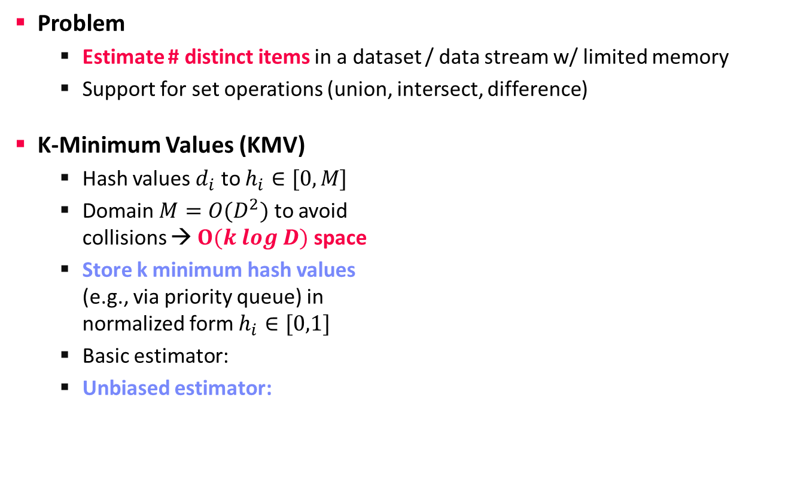
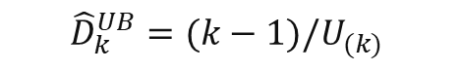
Number of Distinct Items
Data Stream Mining
Problem
Estimate # distinct items in a dataset / data stream w/ limited memory
Support for set operations (union, intersect, difference)
K-Minimum Values (KMV)
Hash values $d_{i}$ to $h_{i}∈[0,M]$
Domain $M=O(D^{2})$ to avoid collisions → $O(k log D)$ space
Store k minimum hash values (e.g., via priority queue) in normalized form $h_{i}∈[0,1]$
Basic estimator:
Unbiased estimator:
Duplicates yield same hash!
0
1
U_{(k=4)}=0.24
$${\hat{D}}_{k}^{BE}=k/U_{(k)}$$
Example: 16.67 vs 12.5
$${\hat{D}}_{k}^{UB}=(k−1)/U_{(k)}$$
[Kevin S. Beyer, Peter J. Haas, Berthold Reinwald, Yannis Sismanis, Rainer Gemulla: On synopses for distinct-value estimation under multiset operations. SIGMOD 2007]

Slide 27
Stream Summarization
Data Stream Mining
[Graham Cormode, S. Muthukrishnan: An Improved Data Stream Summary: The Count-Min Sketch and Its Applications. LATIN 2004]
Problem
Summarize stream in sketch/synopsis w/ limited memory
Finding quantiles, frequent items (heavy hitters), etc
Count-Min (CM) Sketch
Two-dimensional count array of width w and depth d
d hash functions map {1 … n} → {1 … w}
Update (s_{i},c_{i}): compute d hashes for s_{i} and increase counts of all locations
Point query (s_{i}): compute d hashes for s_{i} and estimate frequency as min(count[j,h_{j}(s_{i})])
Unlikely similar hash collisions
h₁
 | 6 |  |  | 2 | 1
1 |  | 3 | 5
3 |  | 4 |  | 1 | 1
 | 1 | 2 | 1 | 5
 | 7 | 1 | 1
h₂
h₃
h₄
h_{d}

Slide 28
Summary and Q&A
Data Stream Processing
Distributed Stream Processing
Data Stream Mining
Next Lectures
13 Distributed Machine Learning Systems [Jan 19]
Written Exam [Feb 02]

